Slide 1
SAP BTP Extension Suite Training
Day 18
Anubhav Oberoy
www.AnubhavTrainings.com
Follow excellence with sheer passion

Slide 2


DISCLAIMER
The training content and delivery of this presentation is confidential, and cannot be recorded, or copied and distributed to any third party, without the written consent of Anubhav Trainings

Slide 3
Agenda – Day 18
01
What is Clean Core
02
Extensibility Model
03
Connect S/4HANA

Slide 4
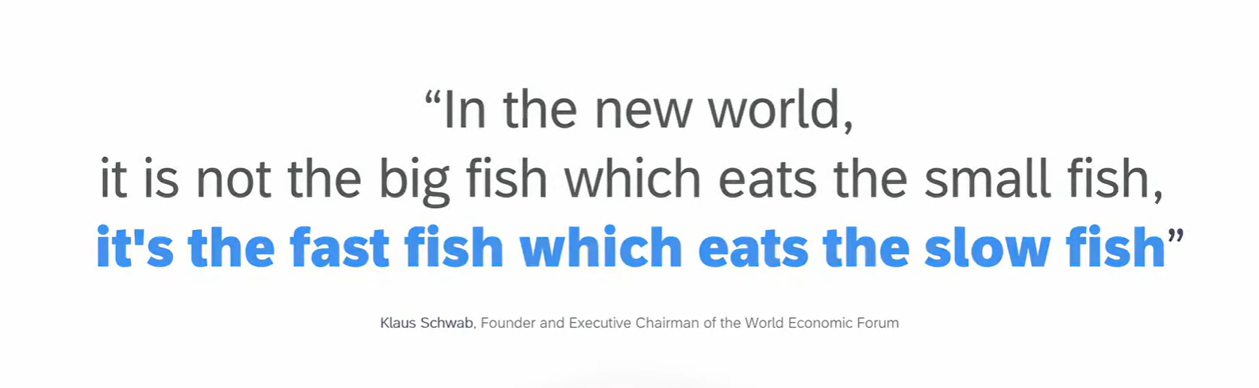
Welcome to the new world

Slide 5



Looming Threats
Geopolitical
Instability
Economic Uncertainties
Disruptive Technologies

Slide 6
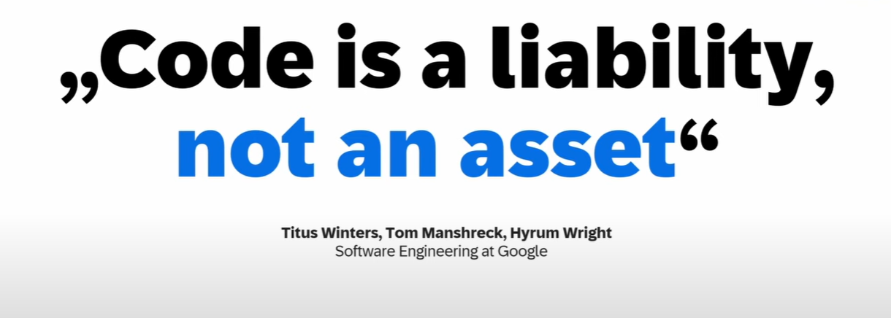
Everything is code

Slide 7
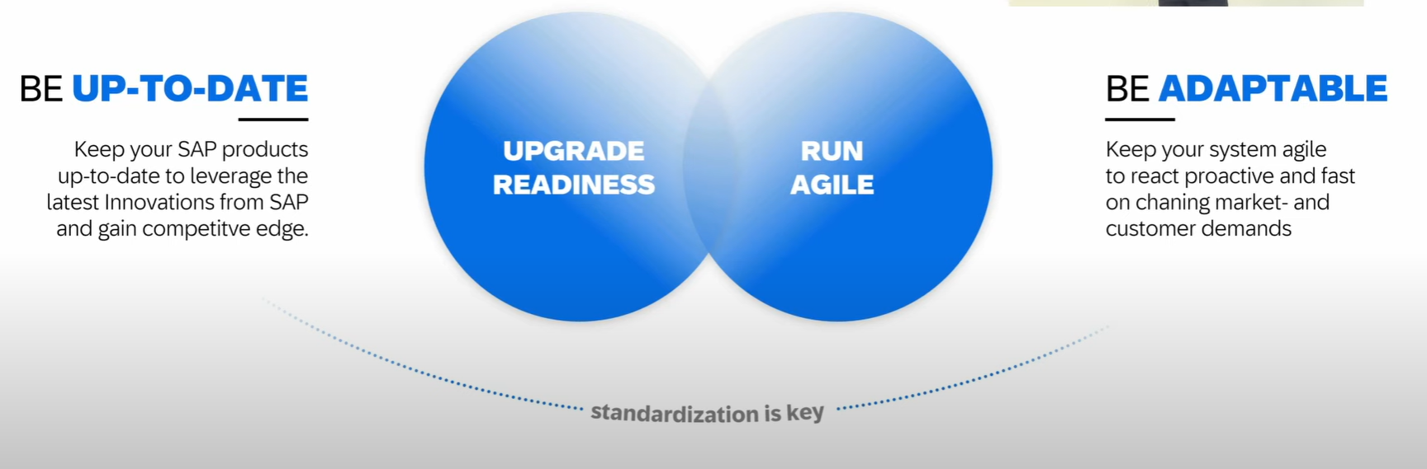
How to be fast

Slide 8
The Clean Core
Clean means up-to-date, documented, unmodified, consistent, efficient and upgrade ready.
S/4HANA Cloud Private Edition => S/4HANA On-premise – GUI Access, Full Control on system, upgrade when customer want, postpone upgrades, SPRO Access, Full access to system code like ECC – 85-90%
S/4HANA Cloud Public Edition => Shared environment, Infra is owned by SAP, not have full control and code, No SAPGUI access, only through browser, Force upgrade (always up to date) -10~15%
Capabilities of clean core depend on Software stack.
Bundle for Rise/Grow with SAP – ERP (Core S/4HANA), BTP (BTPEA), SAC, DS…

Slide 9
Benefits of Clean Core
Access to Innovation – all the latest S/4HANA features can be accessed faster because since you don’t have dependency on custom code, you can upgrade in short time, agile to decide. SAP partners can offer upgrade at fix price.
Upgrade Simplicity – You can apply upgrades stress free.
Lower TCO – Since we follow clean core, we actually use upgrade safe APIs to develop our custom apps. This remains stable release-on-release.
Enhanced security – secure your data and applications which are exposed in cloud.
Improved performance – core is clean, it doesn’t have to interact with lots of custom code, store custom code hence increase the speed.
Data Simplification – which data is privates, which data is public.

Slide 10
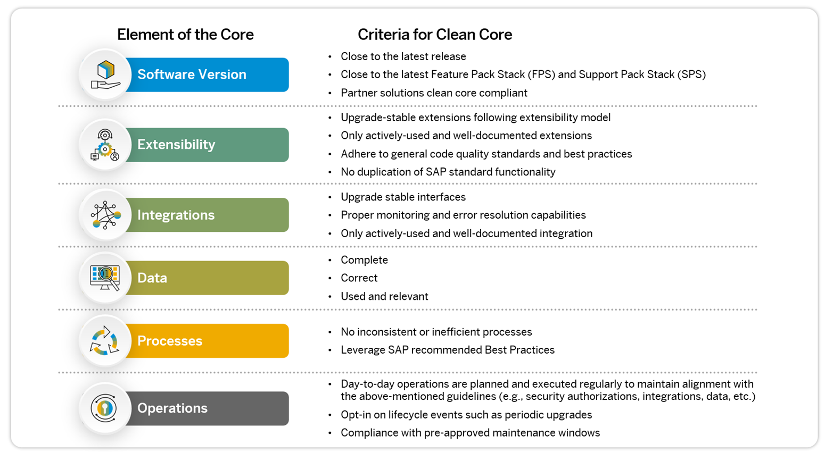
Elements of Clean Core

Slide 11
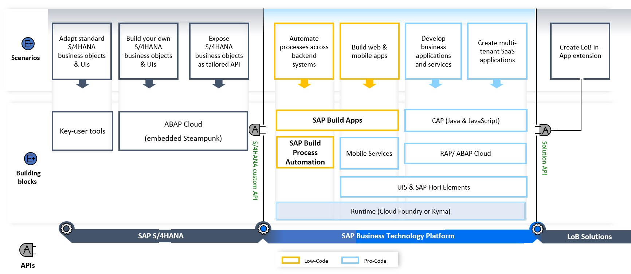

High level guidance

Slide 12
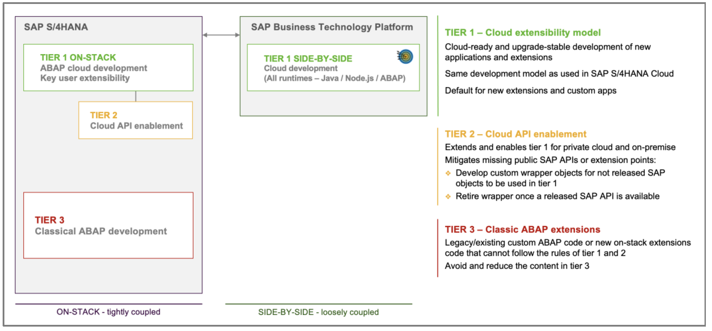
SAP Extensibility Model

Slide 13
SAP Business Accelerator HUB
The SAP Business Accelerator Hub (formerly known as SAP API Business Hub) is a central, cloud-based platform provided by SAP that offers access to a wide range of APIs, pre-packaged integrations, and business services. Located at https://api.sap.com , it serves as a comprehensive catalog for developers, partners, and enterprises looking to explore, test, and adopt SAP's digital capabilities. The hub provides resources that span various SAP products like S/4HANA, SuccessFactors, Ariba, and more, enabling seamless integration into SAP and non-SAP systems through standardized APIs and events.
Users of the SAP Business Accelerator Hub can interact with APIs in a live sandbox environment, download pre-configured integration packages, and access detailed documentation and code snippets. The platform supports both SAP BTP (Business Technology Platform) and third-party development, accelerating innovation and reducing time to value. It is an essential tool for enterprises undergoing digital transformation, allowing for rapid prototyping, scalable integration, and efficient development across a variety of business domains.

Slide 14
What is Extensibility
Extensibility is a key capability of SAP ECC and SAP S/4HANA. It enables customers to create a competitive advantage by customizing their business processes and allows partners to enrich core ECC or S/4HANA with tailor-made solutions
During the last decades SAP’s on-premise customers and partners have mainly used classic ABAP extensibility to extend their ERP solution. Classic extensibility allows ABAP developers to use and even to modify all SAP objects. Although, classic extensibility is very powerful and flexible, it is no longer a good option in today’s cloud world.
In-lined with cloud strategy, SAP S/4HANA provides a new upgrade-stable cloud extensibility model that clearly separates SAP code and extensions via public SAP APIs and SAP extension points.

Slide 15
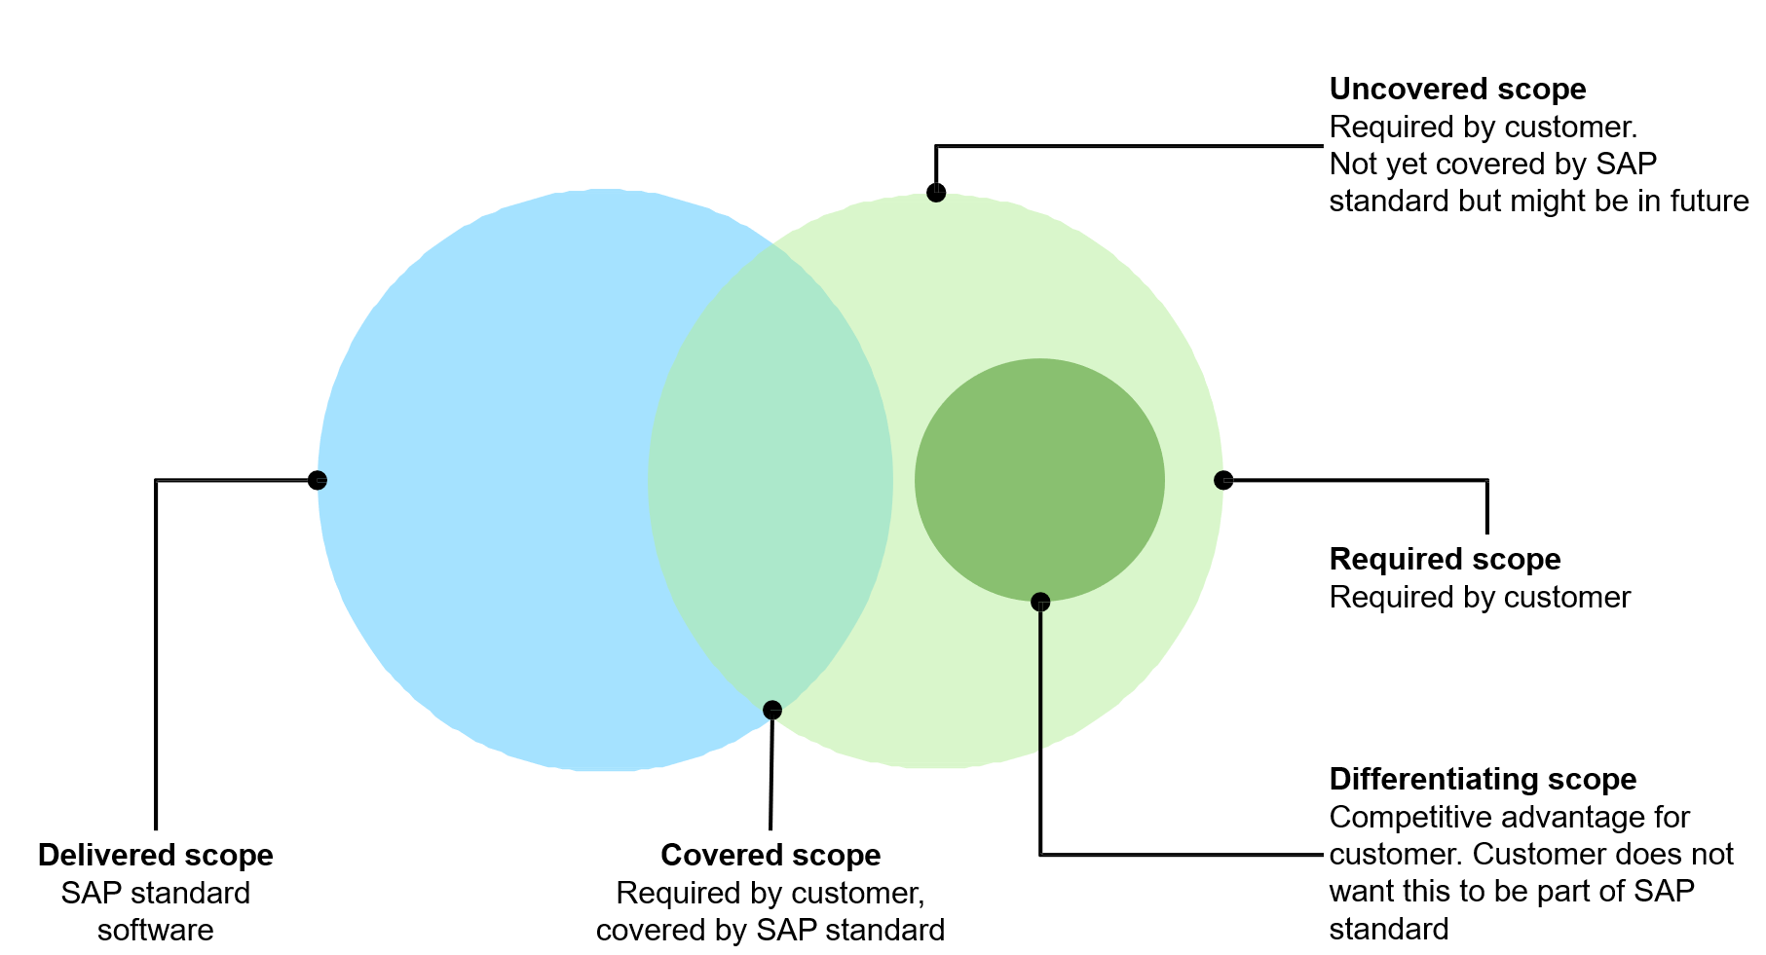
What is Extension?
We all know that standard SAP software doesn’t cover the scope of all the company business processes. There is always a need for a new app, a new report, or a new functionality. SAP partners and customers have been traditionally building extensions on SAP ECC system using ABAP code. However, with SAP S/4HANA and customer’s digital transformation journey towards cloud, we need a more robust yet loosely coupled extensibility model.

Slide 16
Classic Extensions and Challenges
Traditionally, SAP partners and customers have been using classic ABAP extensibility to extend their ERP solution.
Classic Extensibility (aka classic ABAP custom development) in SAP S/4HANA (or in SAP ECC):
Allows you to use classic development tools and techniques (e.g., transaction SE80, Eclipse IDE, BAdIs etc.)
Very rich of features and functions.
Extremely flexible and even allows you to modify SAP code itself.
Although, being very powerful, flexible, and popular, classic extensibility has some major drawbacks.
One of them is High Upgrade Efforts!
The missing clear interface between SAP code and extensions might lead to issues in the extensions during upgrades. As a result, upgrades require high planning, regression test, and adaption efforts, which is one of the reasons why customers delay upgrades.
Example:
You have used an SAP object that is not whitelisted by SAP in your extension. After an upgrade the used SAP Object has been changed or deleted. Now you will have to adjust the extension thus upgrade is delayed.

Slide 17
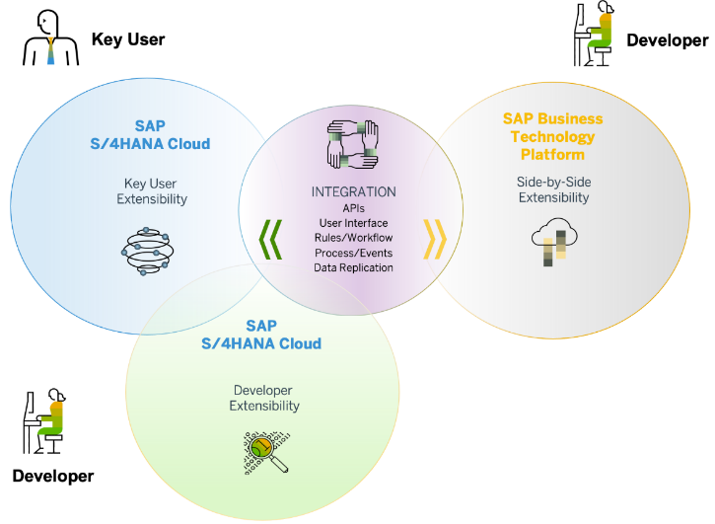
Clean Core and Benefits
Clean core is an extension methodology in which
Extensions are kept strictly separate from the SAP application.
Extensions access SAP business objects only through well defined, upgrade-stable interfaces
By following clean core paradigm, you make sure that
Extensions do not break an upgrade and upgrades do not break an extension.
Extensions do not create a problem when you migrate from SAP S/4HANA on-Premise to SAP S/4HANA Cloud
SAP’s rationale behind the “clean core” paradigm is simple – Allow customers to extend their SAP S/4HANA software while making the software updates eventually non-events.
Clean core paradigm is the back-bone of S/4HANA new extensibility model. It provides following benefits
Reduce TCO
Make upgrades non-events from a custom code point of view
Reduce test efforts for business users
Reduce adaption efforts for developers
IT service providers can offer upgrade projects at a fixed price
Speed and Innovation
Absorb innovation delivered by SAP at a faster rate
React fast on changing business requirements
Be cloud ready
Lay the foundation today to move to the cloud from a custom extension perspective

Slide 18
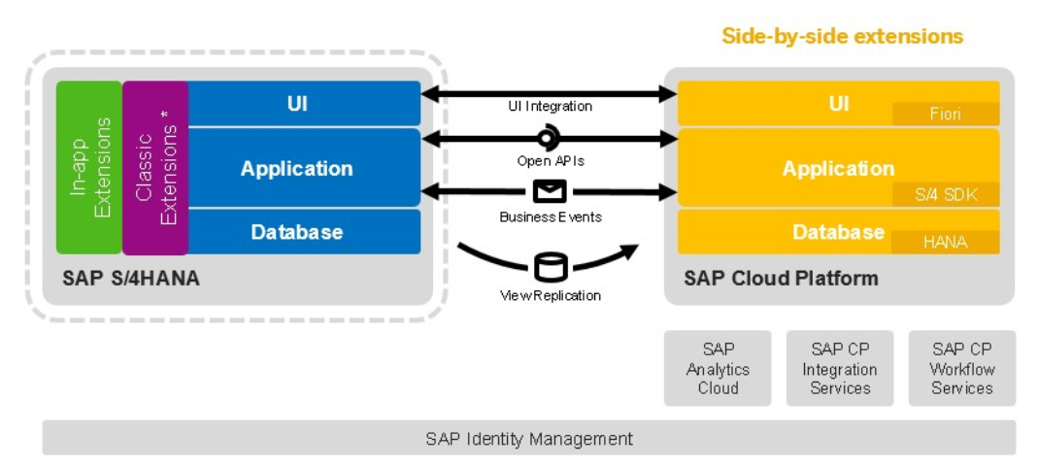
Approaches for Side-by-Side Extension

Slide 19
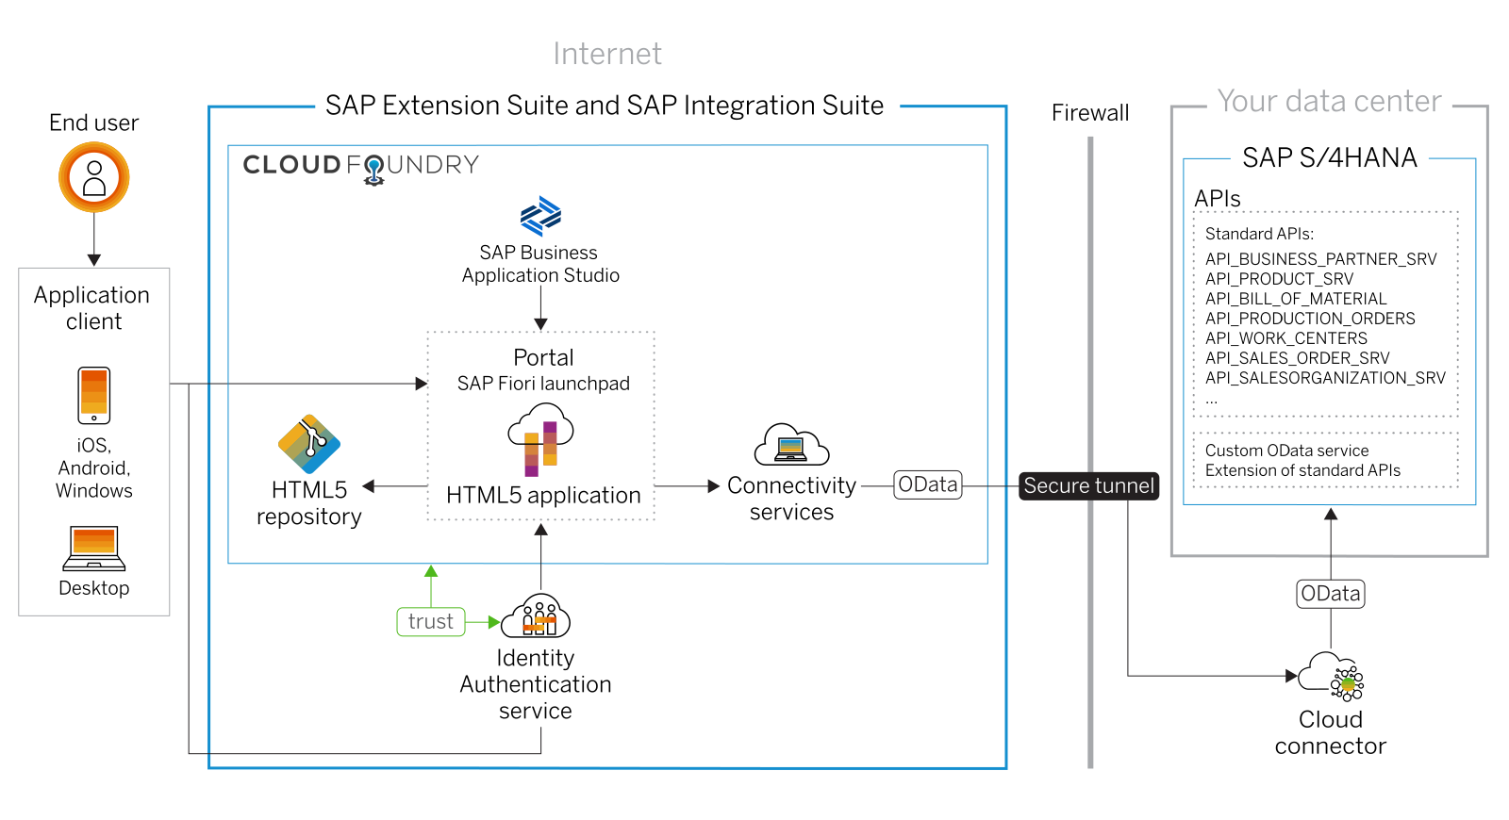

Scenario 1: UI Extensibility

Slide 20



























Slide 23

What We Did
Let’s Summarize

Slide 24

www.anubhavtrainings.com
Thank You
End of Day 17

Slide 25


We’re committed to empower you to be
#FutureReady
through powerful training solutions.
We build the workforce of the future.
260+
Corporate Clients
60,000+
Learners Trained
26000+
Learners Placed
FREE WEBINARS
Sign up for free webinars with industry experts every fortnight!
Enroll Now!
Contact us today!
https://anubhavtrainings.com

